Slide 1

Introduction to
Heroku
John Stevenson
Developer Advocate
Salesforce / Heroku

Slide 2
Safe Harbor
Safe harbor statement under the Private Securities Litigation Reform Act of 1995:
This presentation may contain forward-looking statements that involve risks, uncertainties, and assumptions. If any such uncertainties materialize or if any of the assumptions proves incorrect, the results of salesforce.com, inc. could differ materially from the results expressed or implied by the forward-looking statements we make. All statements other than statements of historical fact could be deemed forward-looking, including any projections of product or service availability, subscriber growth, earnings, revenues, or other financial items and any statements regarding strategies or plans of management for future operations, statements of belief, any statements concerning new, planned, or upgraded services or technology developments and customer contracts or use of our services.
The risks and uncertainties referred to above include – but are not limited to – risks associated with developing and delivering new functionality for our service, new products and services, our new business model, our past operating losses, possible fluctuations in our operating results and rate of growth, interruptions or delays in our Web hosting, breach of our security measures, the outcome of intellectual property and other litigation, risks associated with possible mergers and acquisitions, the immature market in which we operate, our relatively limited operating history, our ability to expand, retain, and motivate our employees and manage our growth, new releases of our service and successful customer deployment, our limited history reselling non-salesforce.com products, and utilization and selling to larger enterprise customers. Further information on potential factors that could affect the financial results of salesforce.com, inc. is included in our annual report on Form 10-Q for the most recent fiscal quarter ended April 30, 2011. This documents and others containing important disclosures are available on the SEC Filings section of the Investor Information section of our Web site.
Any unreleased services or features referenced in this or other presentations, press releases or public statements are not currently available and may not be delivered on time or at all. Customers who purchase our services should make the purchase decisions based upon features that are currently available. Salesforce.com, inc. assumes no obligation and does not intend to update these forward-looking statements.
Proprietary & Confidential
Notes:
Maybe a venn diagram to illustrate these definitions better?

Slide 3
Why consider Heroku ?

Slide 4
Deployment is challenging
“Ops teams are overwhelmed by developer requests”
“Different environments are not always the same. Patching and internal processes often not automated”
“There is a divide in many enterprises between the developers & operations teams.”

Slide 5
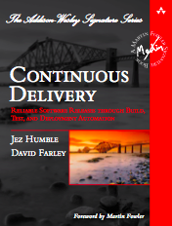
Continuous Delivery
“..reducing the cycle time between an idea and usable software”
- Martin Fowler
“Software delivers no revenue until it is in the hands of its users.”
-Jez Humble
“.. leads to deeper relationship between IT, their business customer, and their final customers.”
-Jez Humble

Slide 6
Cloud Services should be easy
“Should have a natural way to use the services that fits into each teams existing workflow”
“Should be easy to see the value & cost benefits”
“Should be as trust worthy as any internal service, if not more so.”

Slide 7
Demo: 30 second app
Creating live apps should be fast…
Notes:
----- Meeting Notes (16/01/2013 11:59) -----
Create a new app via the website & on the command line.
Show the addon market place, apps control panel & the dev center.

Slide 8
What is Heroku ?

Slide 9




4 core principles
Forget
Servers
Run
Anything
See
Everything
Trust &
Manage

Slide 10
Forget servers
What is Heroku ?

Slide 11

Introducing Dynos
A self contained resource in which to run your application (Linux container)
A logical abstraction over servers
Application scalability is more valuable than number of servers

Slide 12
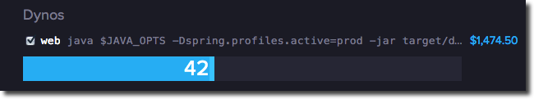
Introducing Dynos
A self contained resource in which to run your application (Linux container)
Allows a trivial way to scale your app
and know how much its costing you!

Slide 13
Inside an Heroku Dyno
Embedded Container
Jetty, Tomcat, etc
Application
Dependencies
Maven, Gradle, SBT, Leiningen, Bundle, etc.
Your Application code
Any application
Any framework
(Spring, Play!, django, compojure,etc.)

Slide 14
Heroku For Developers
For each developer app created
- 1 Dyno with 750 hours per month free
Note: 31 days X 24 hours = 744 hours
You can create as many Heroku applications as required

Slide 15
Forget Servers
Focus 100% on code
Fully managed platform
Trust Heroku to be your DevOps support

Slide 16
Run Anything
What is Heroku ?

Slide 17
An Elastic
“polyglot”
Platform-as-a-Service
pol·y·glot [pol-ee-glot]
adjective
1. able to speak or write several languages; multilingual.
2. containing, composed of, or written in several languages

Slide 18






First class languages on Heroku

Slide 19
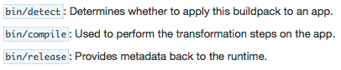
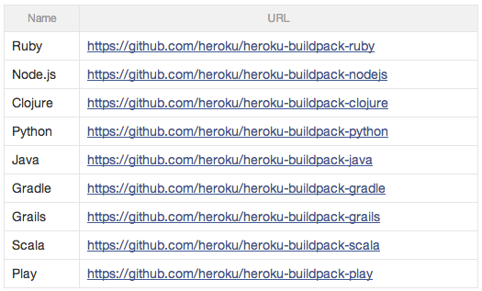
Heroku BuildPacks

Slide 20
Additional languages through “Build packs”
Use a 3rd party build pack
Define your own build, deploy & run cycle
Create your Heroku application with a build pack
heroku create myapp –buildpack
https://github.com/a/buildpack.git

Slide 21
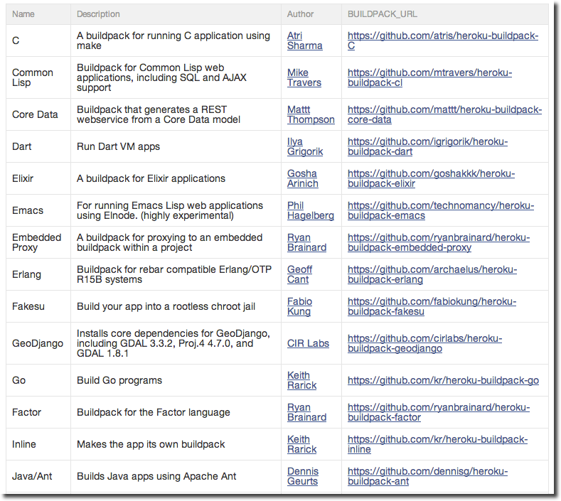
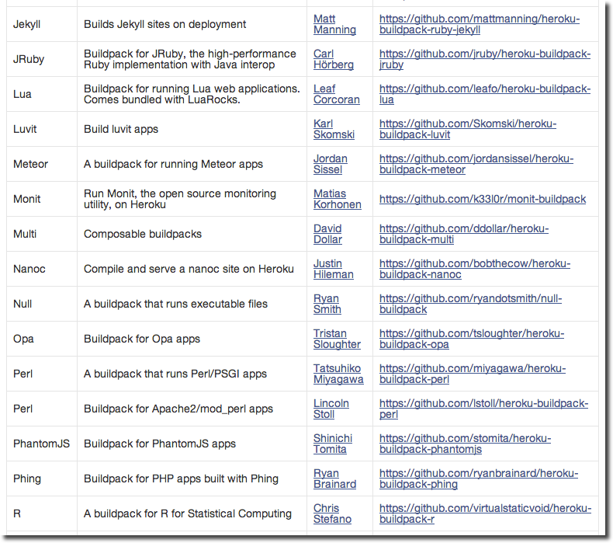
Many build packs on Github

Slide 22















Polyglot frameworks & data sources
Open Frameworks
Open Languages
Open Databases
Sinatra
Ruby on Rails
Play!
Mongo DB
Amazon RDS
Postgres
Ruby
Clojure
Node.JS
Spring
Lift
Waves
Halcyon
Noir
database.com
Couch DB
Redis
Padrino
Ring
Compojure
Java
Scala

Slide 23
Trust & manage

Slide 24
Effortless Scaling
Scale
(running processes)
Web
Worker
Workload Diversity
(Process types)

Slide 25
Running your app processes – The Procfile
Procfile
A simple, declarative way to define application
process types, so they can be easily
managed in unison when scaling.
A text file in the root of your project containing runtime commands & parameters

Slide 26
Procfile examples
Simple web server
web: python -m SimpleHTTPServer $PORT
Clojure
web: lein with-profile production trampoline
run -m my-clojure-website.web

Slide 27
Procfile examples
Java, Play framework & Postgres database
web: target/start -Dhttp.port=${PORT}
${JAVA_OPTS}
-DapplyEvolutions.default=true
-Ddb.default.driver=org.postgresql.Driver
-Ddb.default.url=${DATABASE_URL}

Slide 28
Process Types
Define web processes that listen for http/s requests
web: command options
Define other processes with any naming convention that is meaningful in your app
worker: … queue: … priorityworker: …
batch: … scheduler: … maintenance: …

Slide 29
Scaling your app – by process type
$ cat Procfile
web: java $JAVA_OPTS EmbeddedServer
worker: java $JAVA_OPTS YourJavaClass
$ heroku scale web=4 worker=10
Scaling processes... done

Slide 30
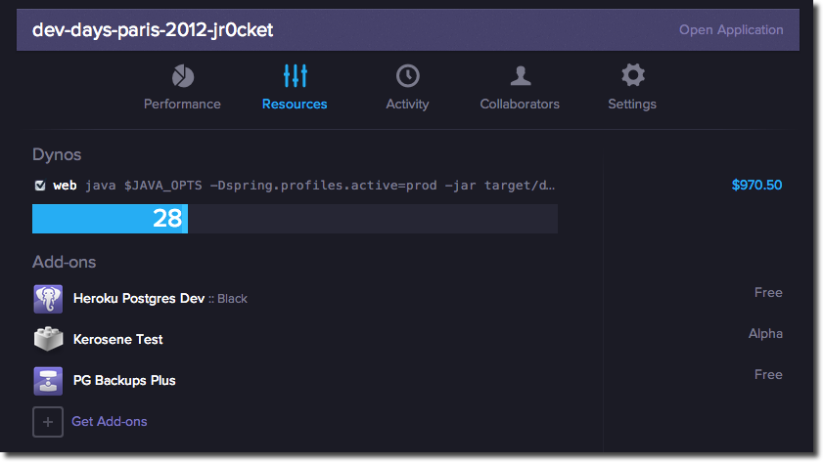
Scaling via web control panel

Slide 31
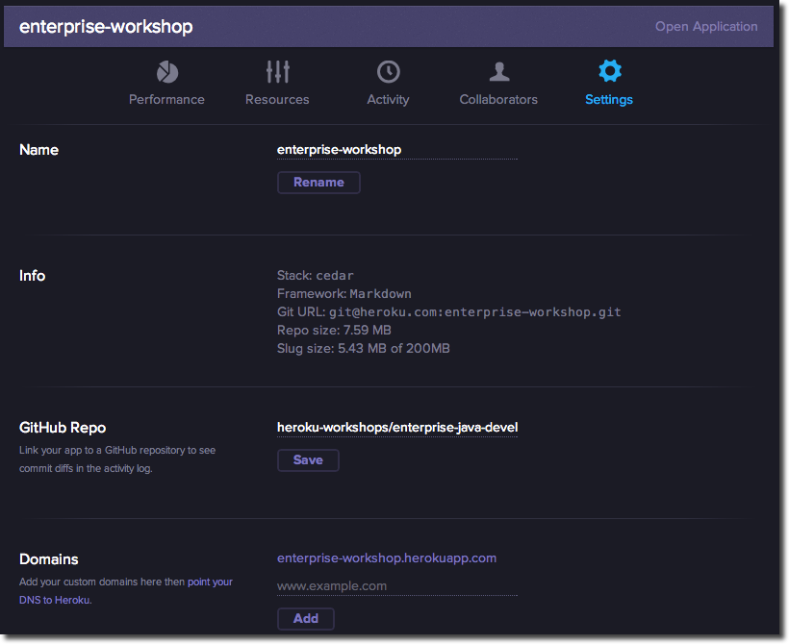
Control apps via Heroku.com

Slide 32
Controlling your application Processes
$ heroku ps
Process State Command
------- ----- -------
web.1 up for 6s java $JAVA_OPTS EmbeddedServer
worker.1 up for 5s java $JAVA_OPTS YourJavaClass
$ heroku ps:restart worker.1
Restarting worker.1 process... Done

Slide 33
Trust & Manage
24x7 platform monitoring
Herokai want to know when there is trouble before you do!

Slide 34
Heroku Status
$ heroku status
=== Heroku Status
Development: No known issues at this time.
Production: No known issues at this time.

Slide 35
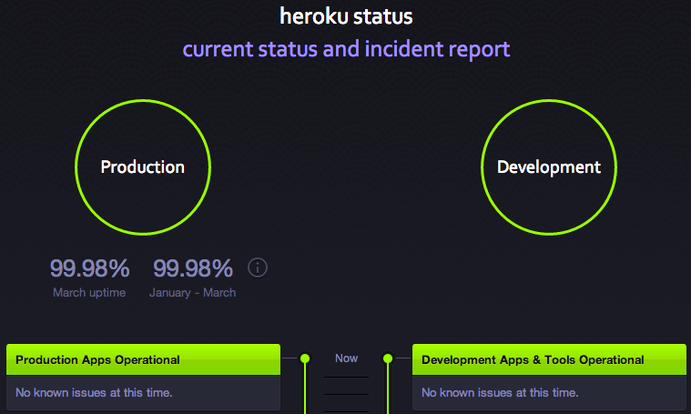
status.heroku.com

Slide 36
See Everything
What is Heroku ?

Slide 37
logplex
Unified logging
- application logs
- administrative commands
infrastructure messages
realtime Dyno information
time-ordered events aggregated from the output streams of all your app’s running processes, system components, and backing services.

Slide 38
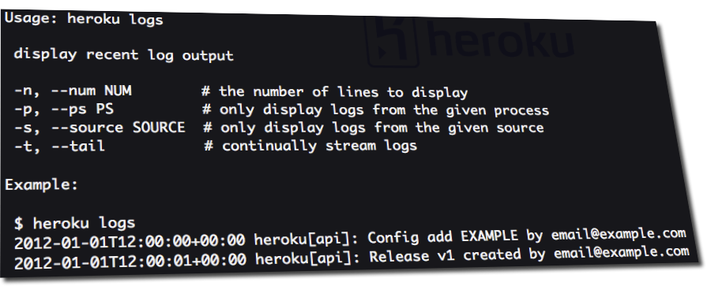
heroku logs
heroku logs --source apps
heroku logs --source heroku
heroku logs --source heroku --ps api

Slide 39
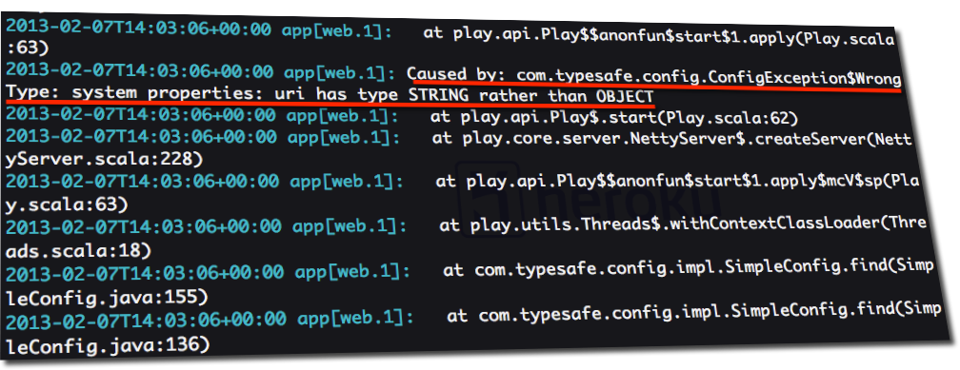
Example of errors in logs

Slide 40
Heroku add-ons
What else is there to Heroku ?

Slide 41
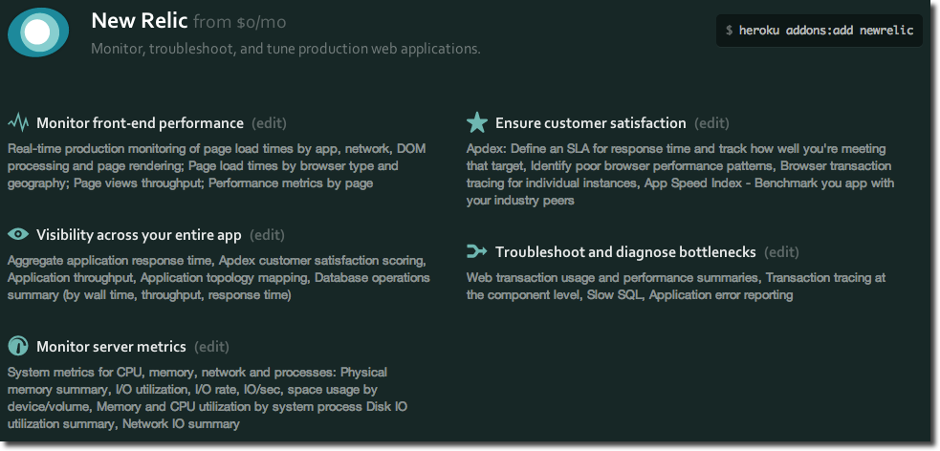
New Relic – end 2 end analysis

Slide 42
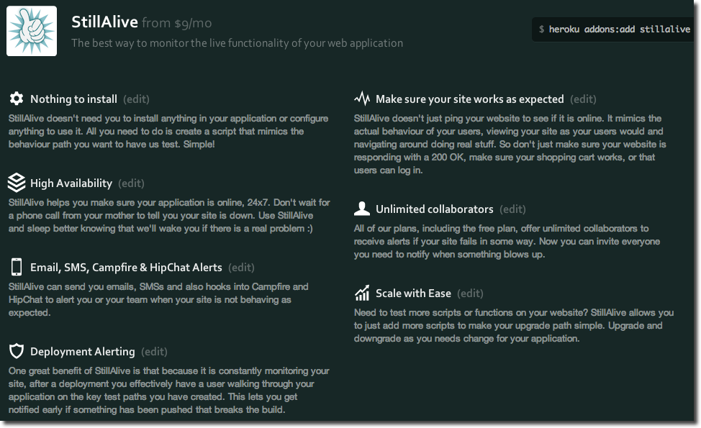
StillAlive – High availability

Slide 43
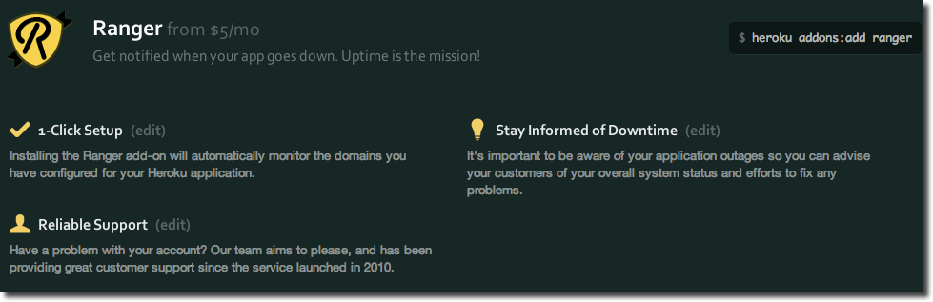
Ranger – monitor domains

Slide 44
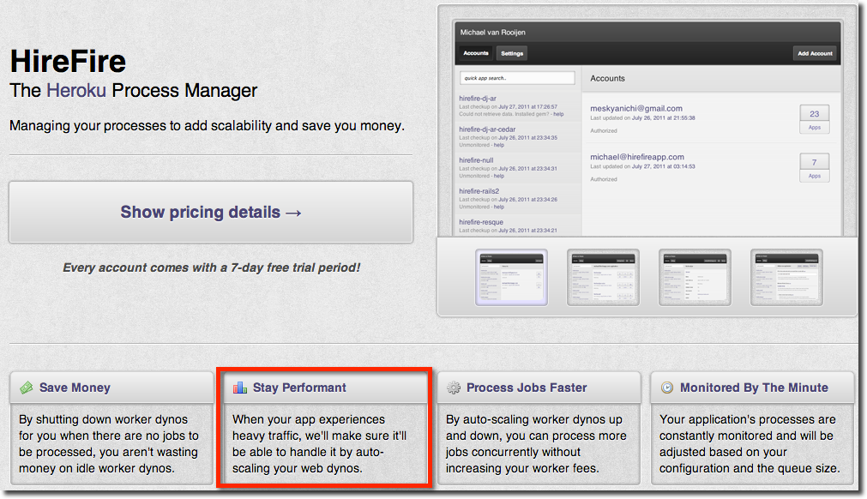
HireFire – auto-scaling

Slide 45


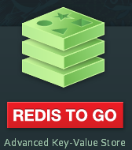



Extensibility
A range of Relational & NoSQL databases
Monitoring for your app
…and too much to cover here
https://addons.heroku.com/

Slide 46
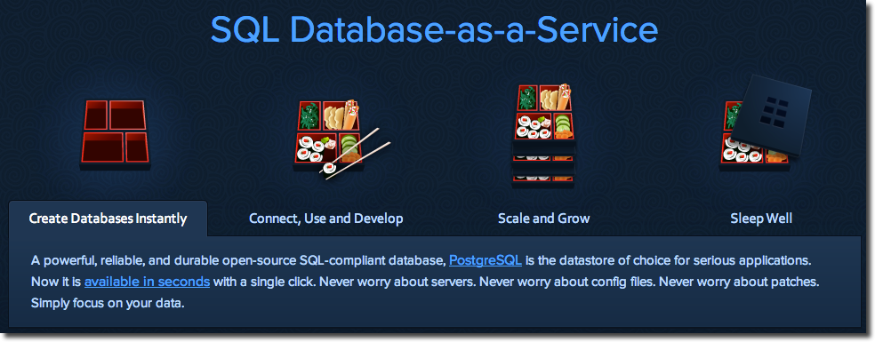
Heroku Postgres - as a service
Powerful data storage
Irrespective of if you app is deployed on Heroku

Slide 47
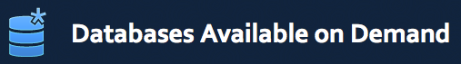







Heroku Postgres - adds more features

Slide 48
Calculating the value
How much does it cost?

Slide 49
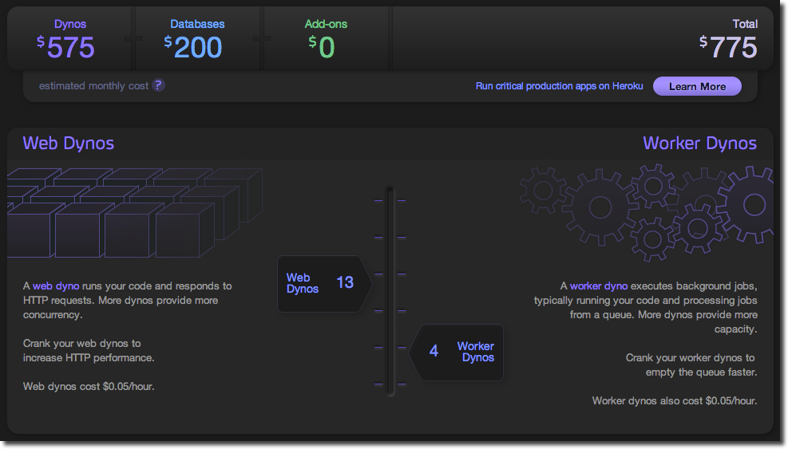
Heroku cost calculator

Slide 50
How much does it really cost to deploy software in your organisation?

Slide 51
Getting started with Heroku
Git Push Deploy

Slide 52
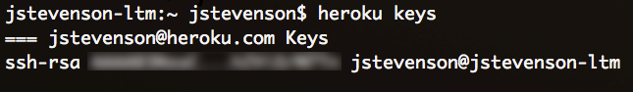
Setup your Heroku account
1) Create an account on Heroku
2) Download the Heroku Toolbelt
3) Upload you public key
heroku login
Or check if you already have a key:

Slide 53
Whats in the Toolbelt?
Heroku command line tools
create | logs | ps | releases | run | addons | config
A Git client
Foreman
run apps locally as they would run on Heroku

Slide 54
5 steps to first deploy
Create you app (using your build tool)
Initialise a git repository for your project
Create your heroku app (heroku create)
Git Commit your files to the local repository
Git Push your app to heroku

Slide 55
Basic continuous deployment workflow
Develop app
Commit locally
git add
Deploy on Heroku
git push heroku master
git commit

Slide 56
Developer workflow
Develop app
Commit locally
git add
Deploy on Heroku
git push heroku master
git commit
Acceptance & unit testing
Integration testing

Slide 57
Collaboration in the cloud
Github and Heroku

Slide 58
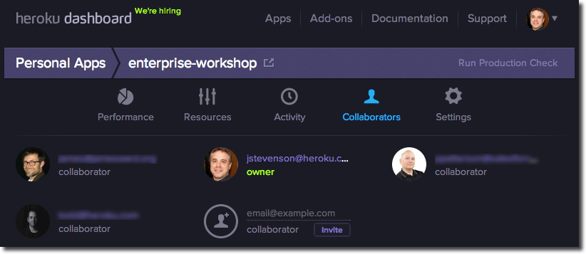
Heroku Collaboration
Add multiple developers to an app

Slide 59
Heroku Collaboration
All collaborators can:
push updates & trigger deployment
view and change app settings
Only Owners can delete the app
or transfer ownership to a different account

Slide 60
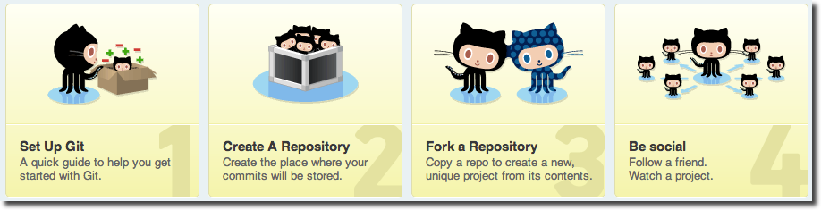
Github – Social Coding
Collaborate on public or private projects
Collaborate 24/7 all over the world

Slide 61
Add Github repo to your app
Create a new repository on Github
Add the repository to your project
git remote add github
git@github.com/account/my-repo.git
Push your code to github
git push –u github master

Slide 62
Collaborative coding on Github
Add developers to your Github repo
only those that you trust!
Encourage pull requests from everyone else
allows collaboration around commits
Facilitate code reviews

Slide 63
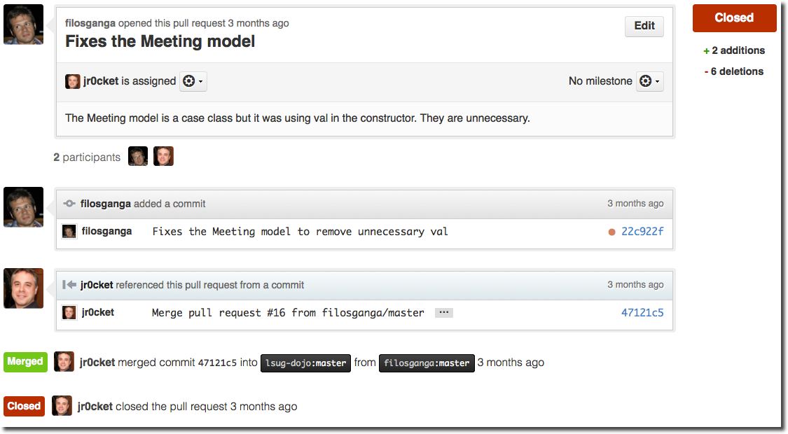
Pull request discussion

Slide 64
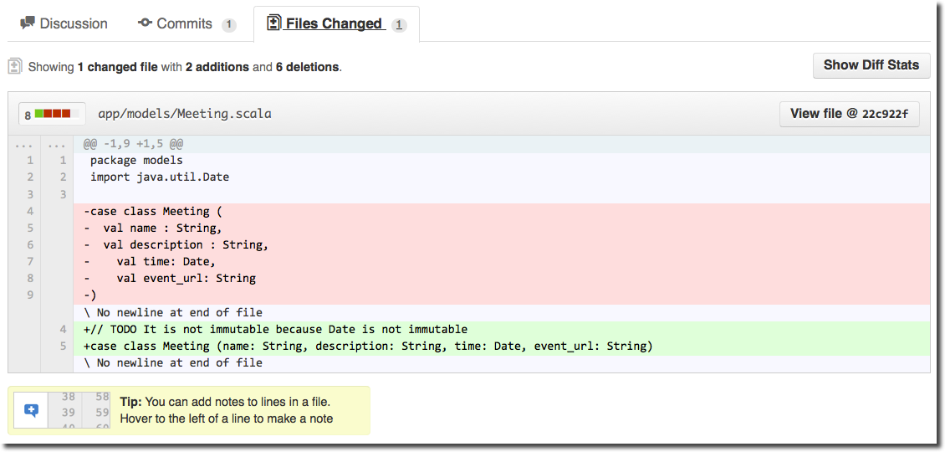
Pull request code review

Slide 65
Adding more environments
Common environments established include:
production, staging, uat, testing, dev (foreman on dev machine)
Create the environments you want
heroku create my-app-staging
heroku create my-app-uat
heroku create my-app-testing
Check add-ons used first
heroku addons --remote heroku

Slide 66
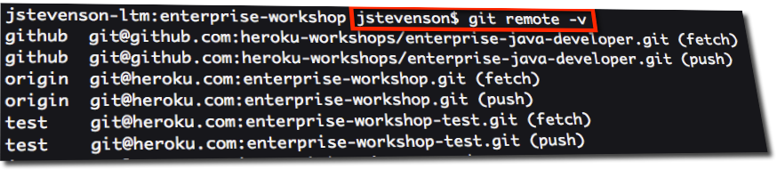
More Envs = more repositories
Every time you create a new Heroku environment a remote git repository is added
git remote –v

Slide 67
Managing multiple repos
Learn to love git log
Configure it to use –graph
Or get a good visual git tool
SourceTree for MacOSX & Windows is great (and free)

Slide 68
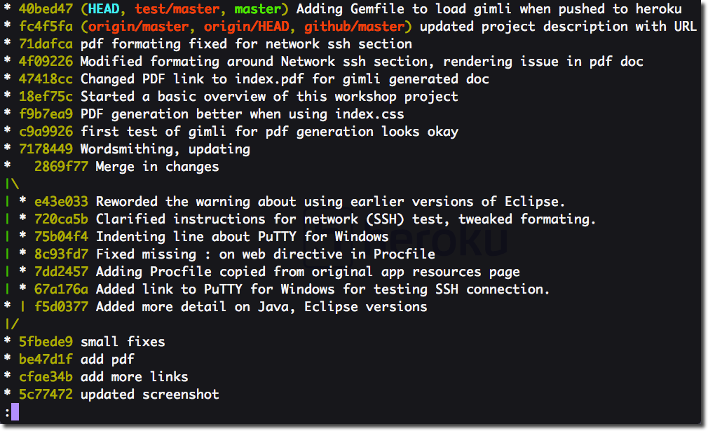
git log --graph --oneline --decorate

Slide 69
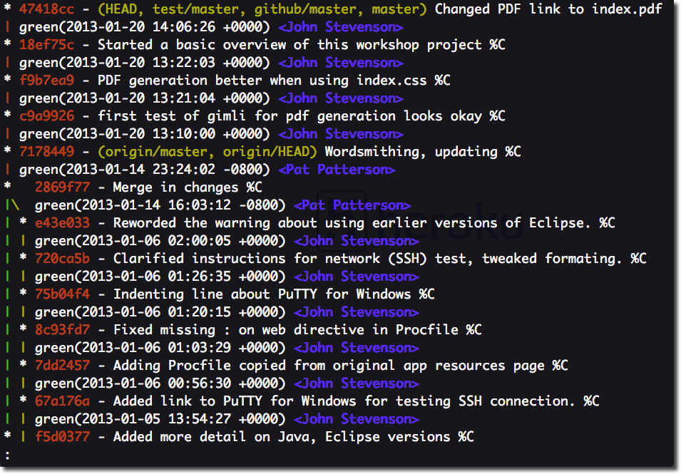
Heroku (origin/master) often behind HEAD & test

Slide 70
Continuous Integration servers

Slide 71
Continuous deployment
Develop app
Commit locally
git add
Deploy on Heroku
git push heroku master
git commit
Acceptance & unit testing
Integration testing

Slide 72
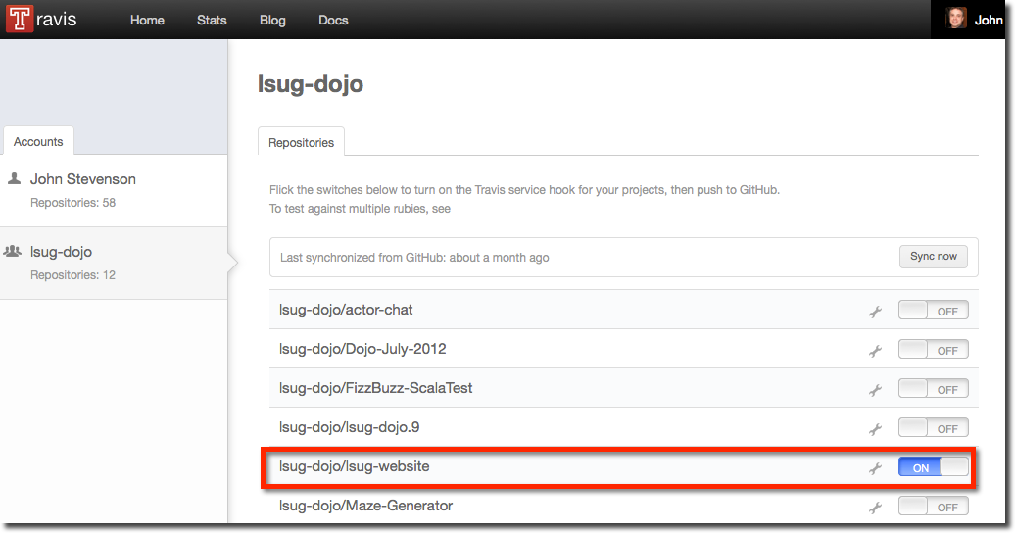
Travis-CI for open projects

Slide 73
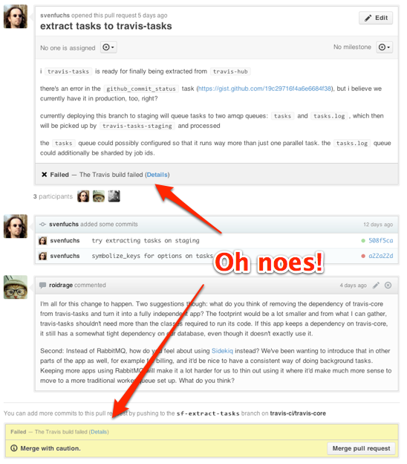

Slide 74
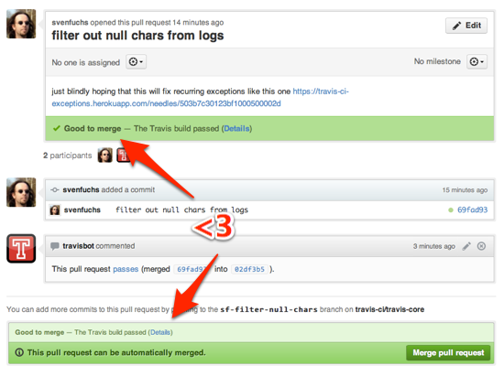

Slide 75
Rolling back your applications
Managing Deployment

Slide 76
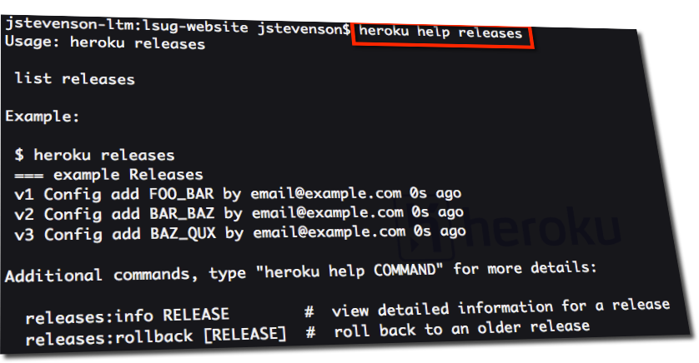
Heroku rollback mechanism

Slide 77
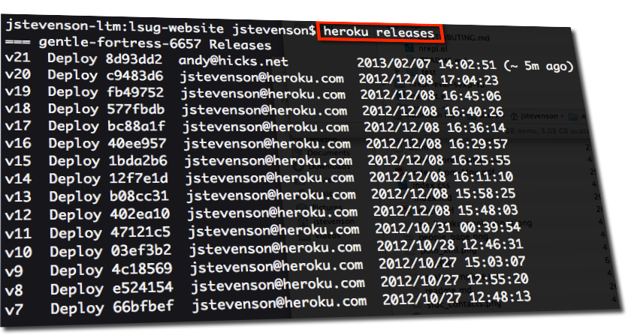
Release History

Slide 78
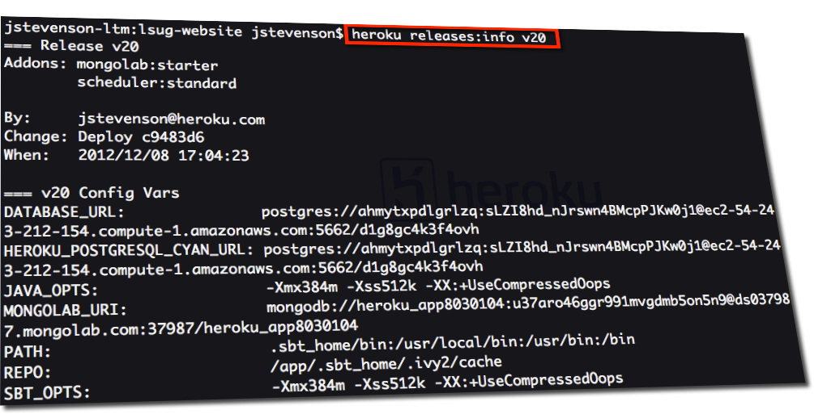
View info about a release

Slide 79
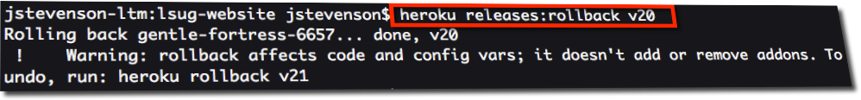
Rollback to a specific version

Slide 80
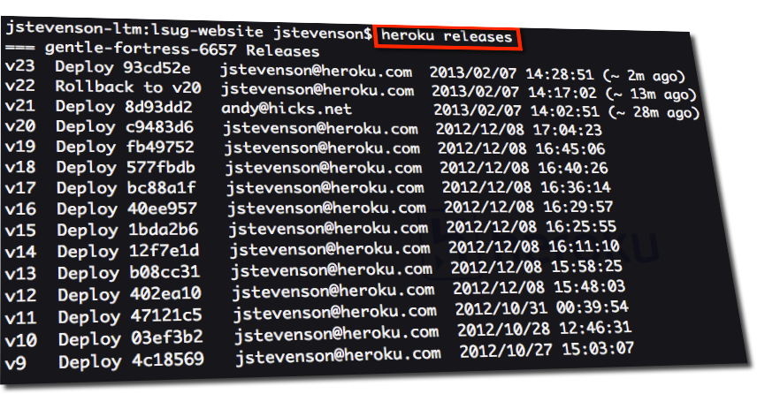
History after rollback & push
Rollback is a temporary solution, fix the root cause!

Slide 81

Try for yourself
Get Started at
http://heroku.com/
Getting started with Heroku guides
http://devcenter.heroku.com/articles/quickstart
London Salesforce Developers
http://www.meetup.com/LondonSalesforceDevelopers/
Thank you !!!

